Slide 1
Html page creation
Syed anas ali

Slide 2
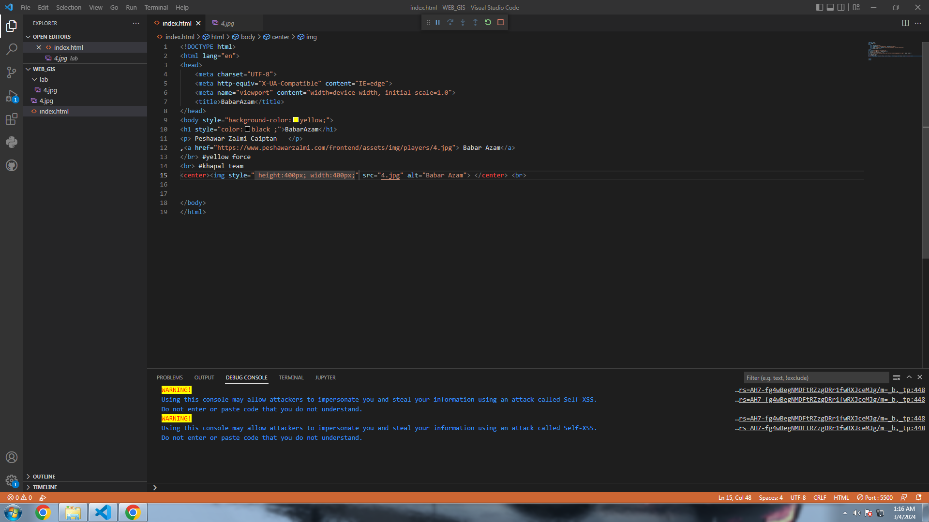

Slide 3
